Slide 1
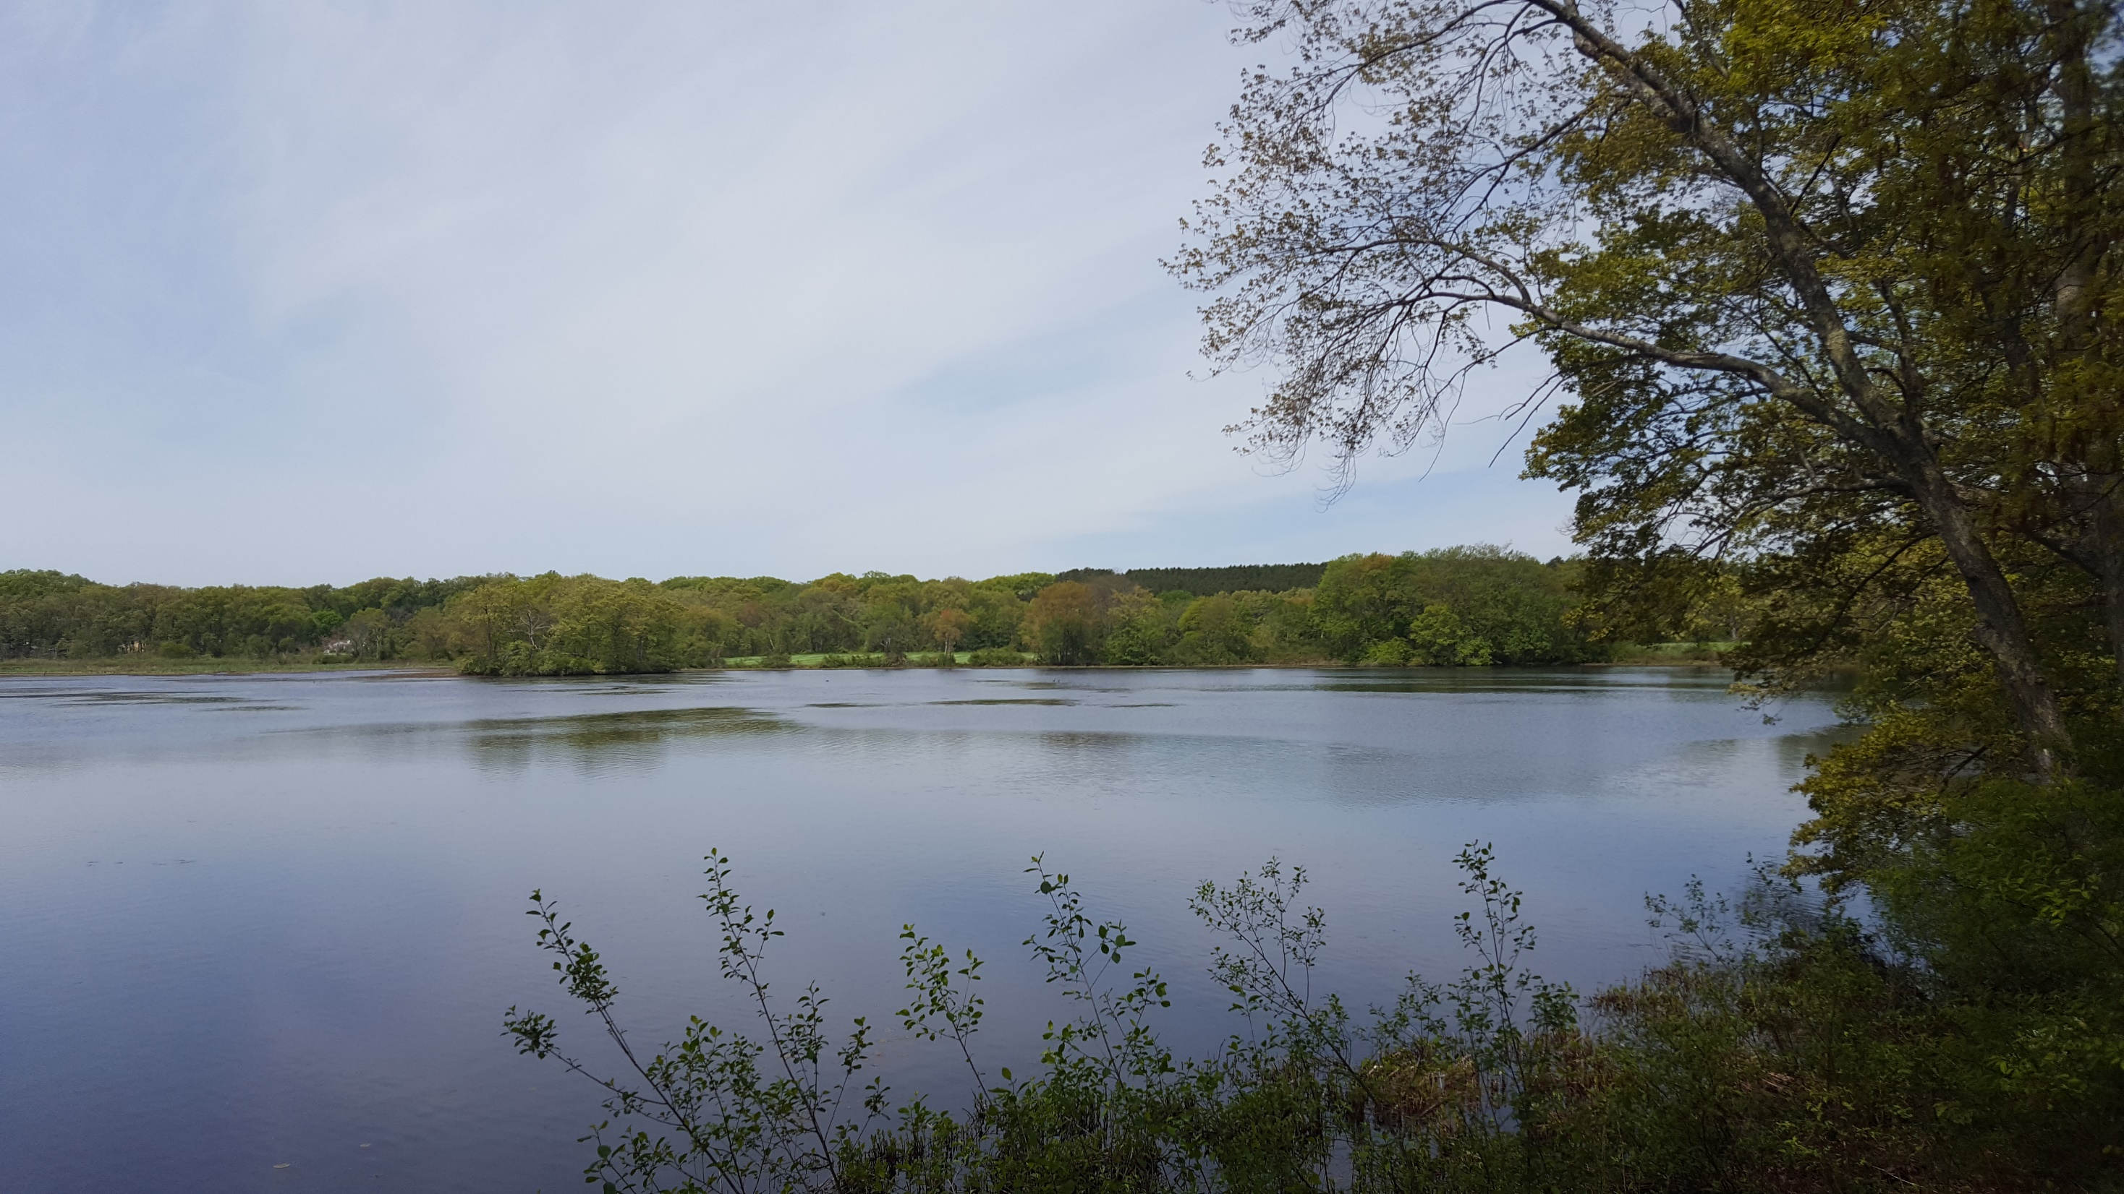
Feasibility Study for the
Gerow Recreation Area
Presentation to the Town of Concord
October 16, 2018

Slide 2
Presentation Outline
1. Park Location / Context
2 . Existing Features
3 . Major Project Components
4. Conceptual Options
5. Open Discussion
Notes:
Major talking points:
We meet or exceed the selection/evaluation requirements
We have a concise team and a local firm with over 30 years of park and campus planning experience
We appreciate the project for it’s opportunities and constraints.
We have the ability and creativity to create an engaging public process and a dynamic work product.

Slide 3
1 Park Location / Context

Slide 4
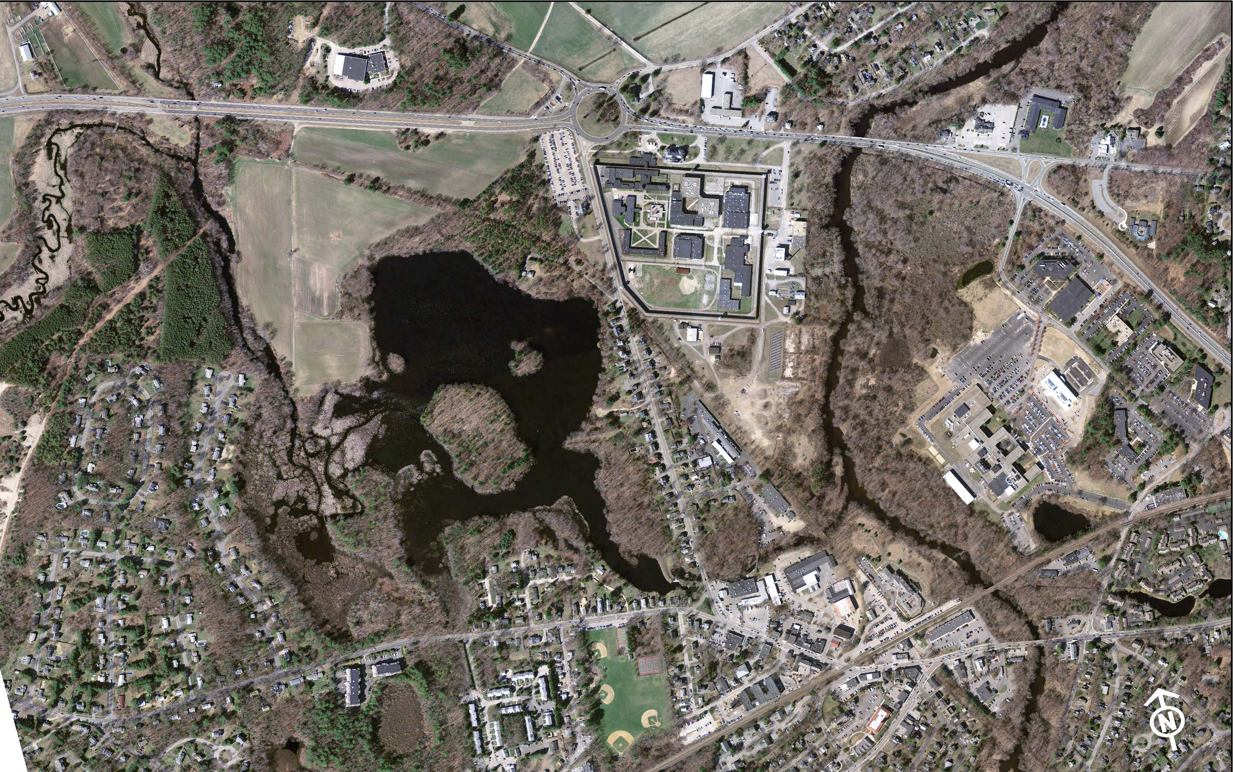
Route 2
Rotary
Route 2
MCI
Concord
Gerow Property
Warner’s
Pond
Commonweatlh Ave. 2
Assabet River
Nashoba
Brook
Project Context
Bruce Freeman Rail Trail
Laws Brook Road
Rideout
Playground
West Concord
Notes:
7.03 acre parcel
54 acre pond
1500 LF shoreline
0.6 mile or 12 minute walk

Slide 5
2 Existing Features

Slide 6
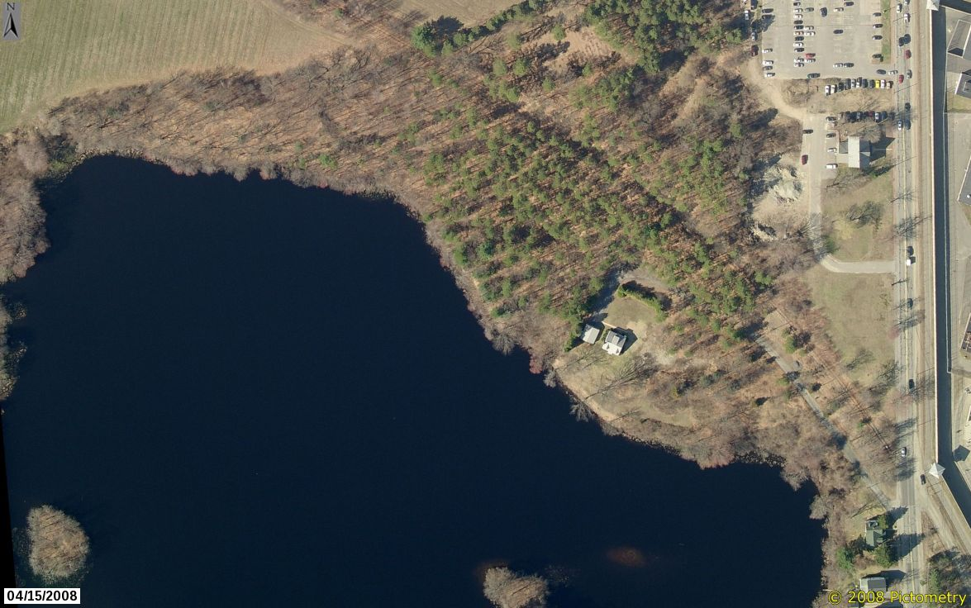
Forested Ridge
BFRT
Pine Forest
Commonwealth Ave.
Cove
House
Lot
Driveway /
Invasive Plants
Warner’s
Pond
Gerow Parcel
Notes:
Four distinct areas:
Driveway area – scattered hardwood trees, heavy ground cover w/ invasive plants, steep shoreline
House lot – predominantly mown lawn, great views to pond, steep shoreline
Pine forest – dense evergreen canopy, dark, very little lower story growth
Cove area – flat, low bank, easy access to water
Forested ridge – oldest/largest hardwoods, steep slopes w. flat ridge line, shoreline shelf

Slide 7
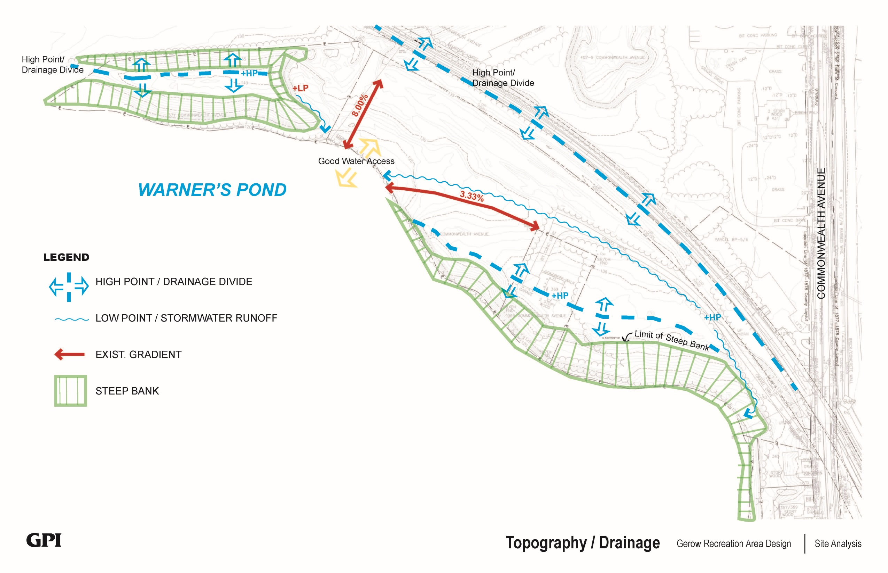
Site Analysis
Notes:
Steep slopes shown with hatching
Natural swale through middle of property
Accessible down to cove

Slide 8
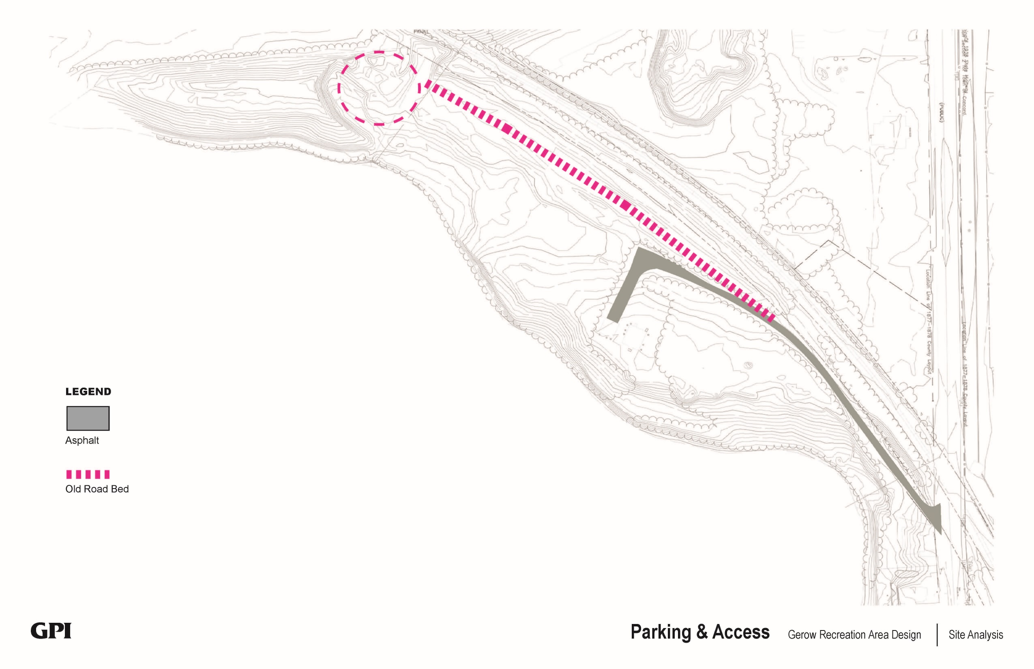
Site Analysis
Notes:
Old road bed and gravel pit

Slide 9
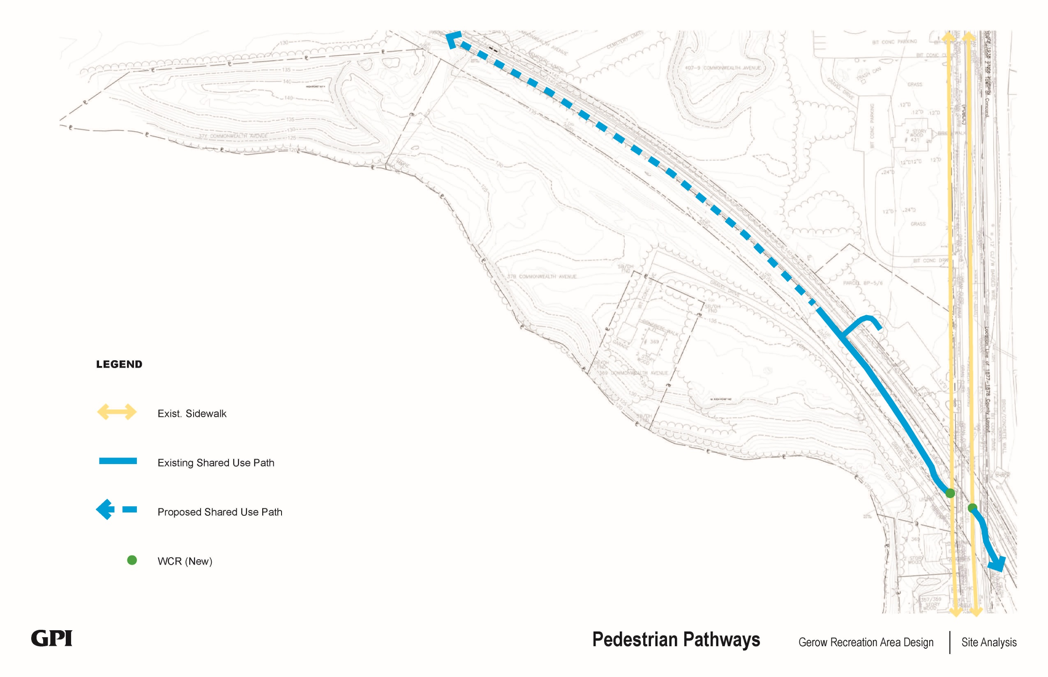
Site Analysis
Notes:
Adjacent multi-use trail.

Slide 10
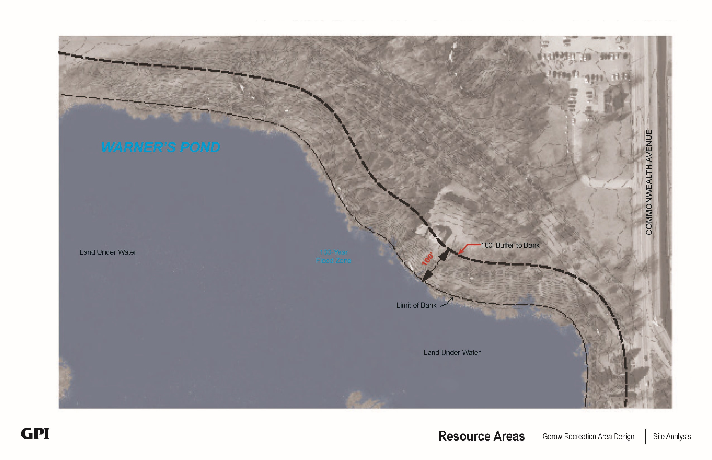
100’ Buffer
25’ No Disturb
Commonwealth Ave.
50’ No Build
Site Analysis
Limit of Bank
Land under water
Notes:
Resource areas w/ Protection zones

Slide 11
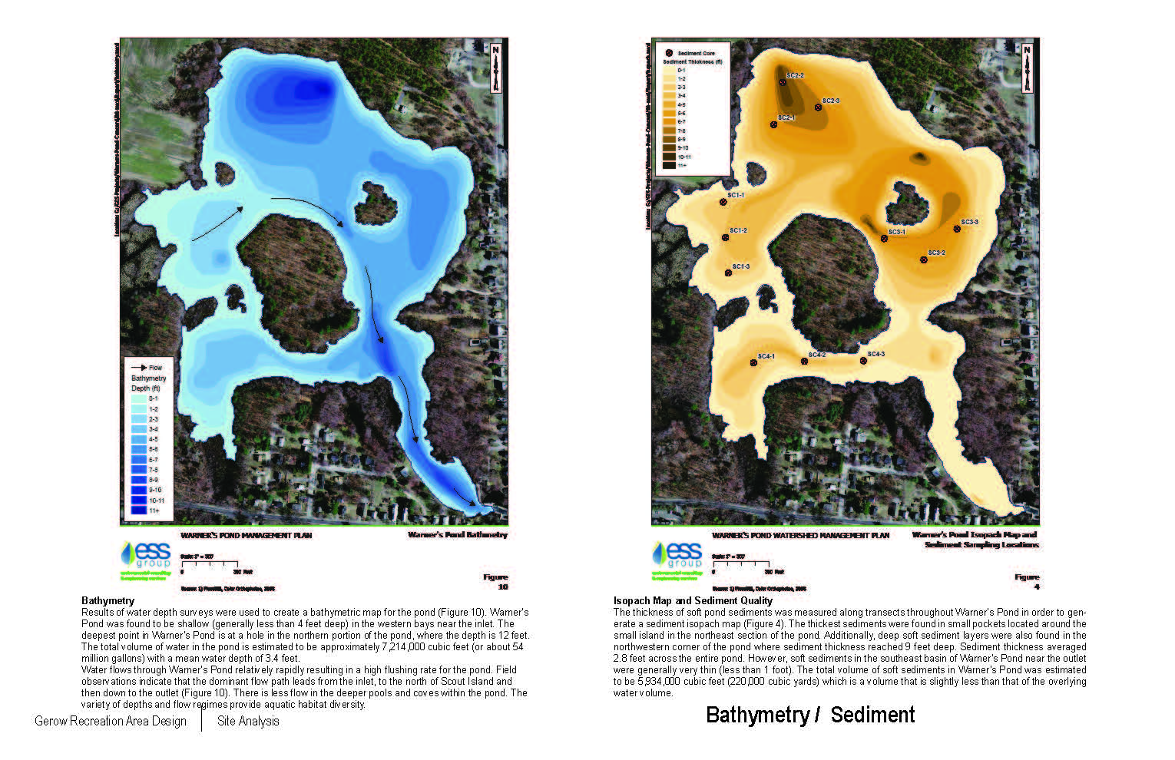
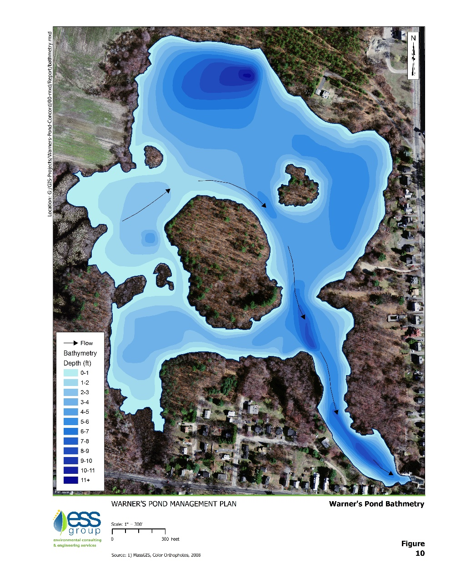
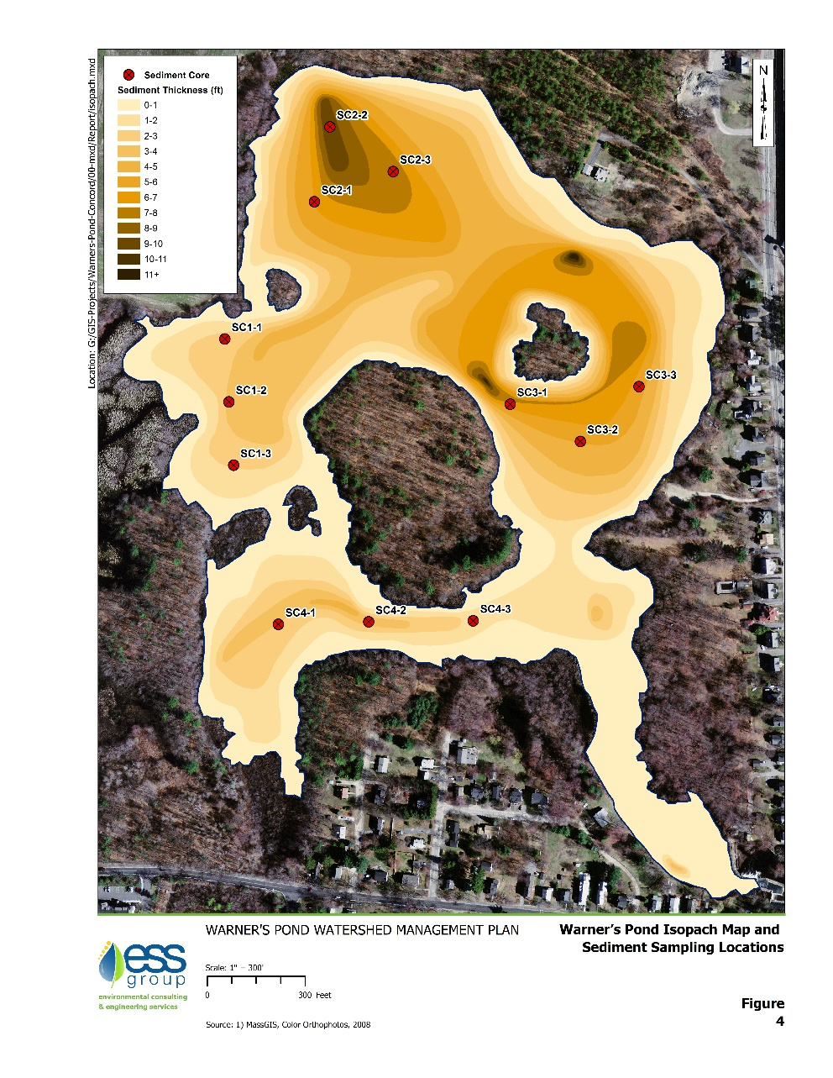
Site Analysis
Notes:
Bathymetry map and Isopach Map
Darker shades indicate depth or thickness

Slide 12
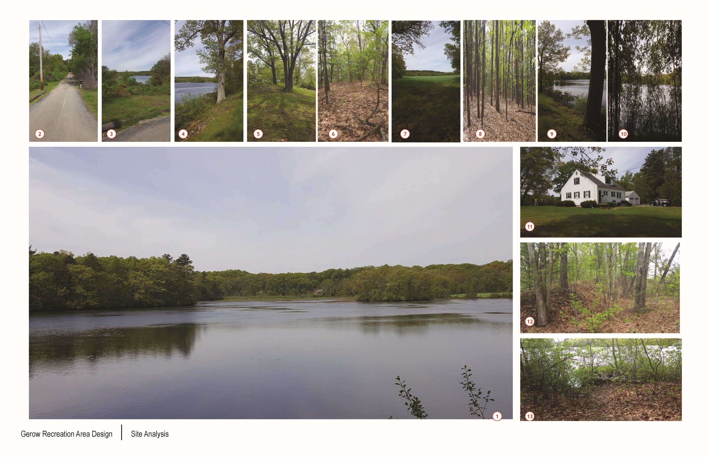
Site Analysis
Notes:
Both internal and external views

Slide 13
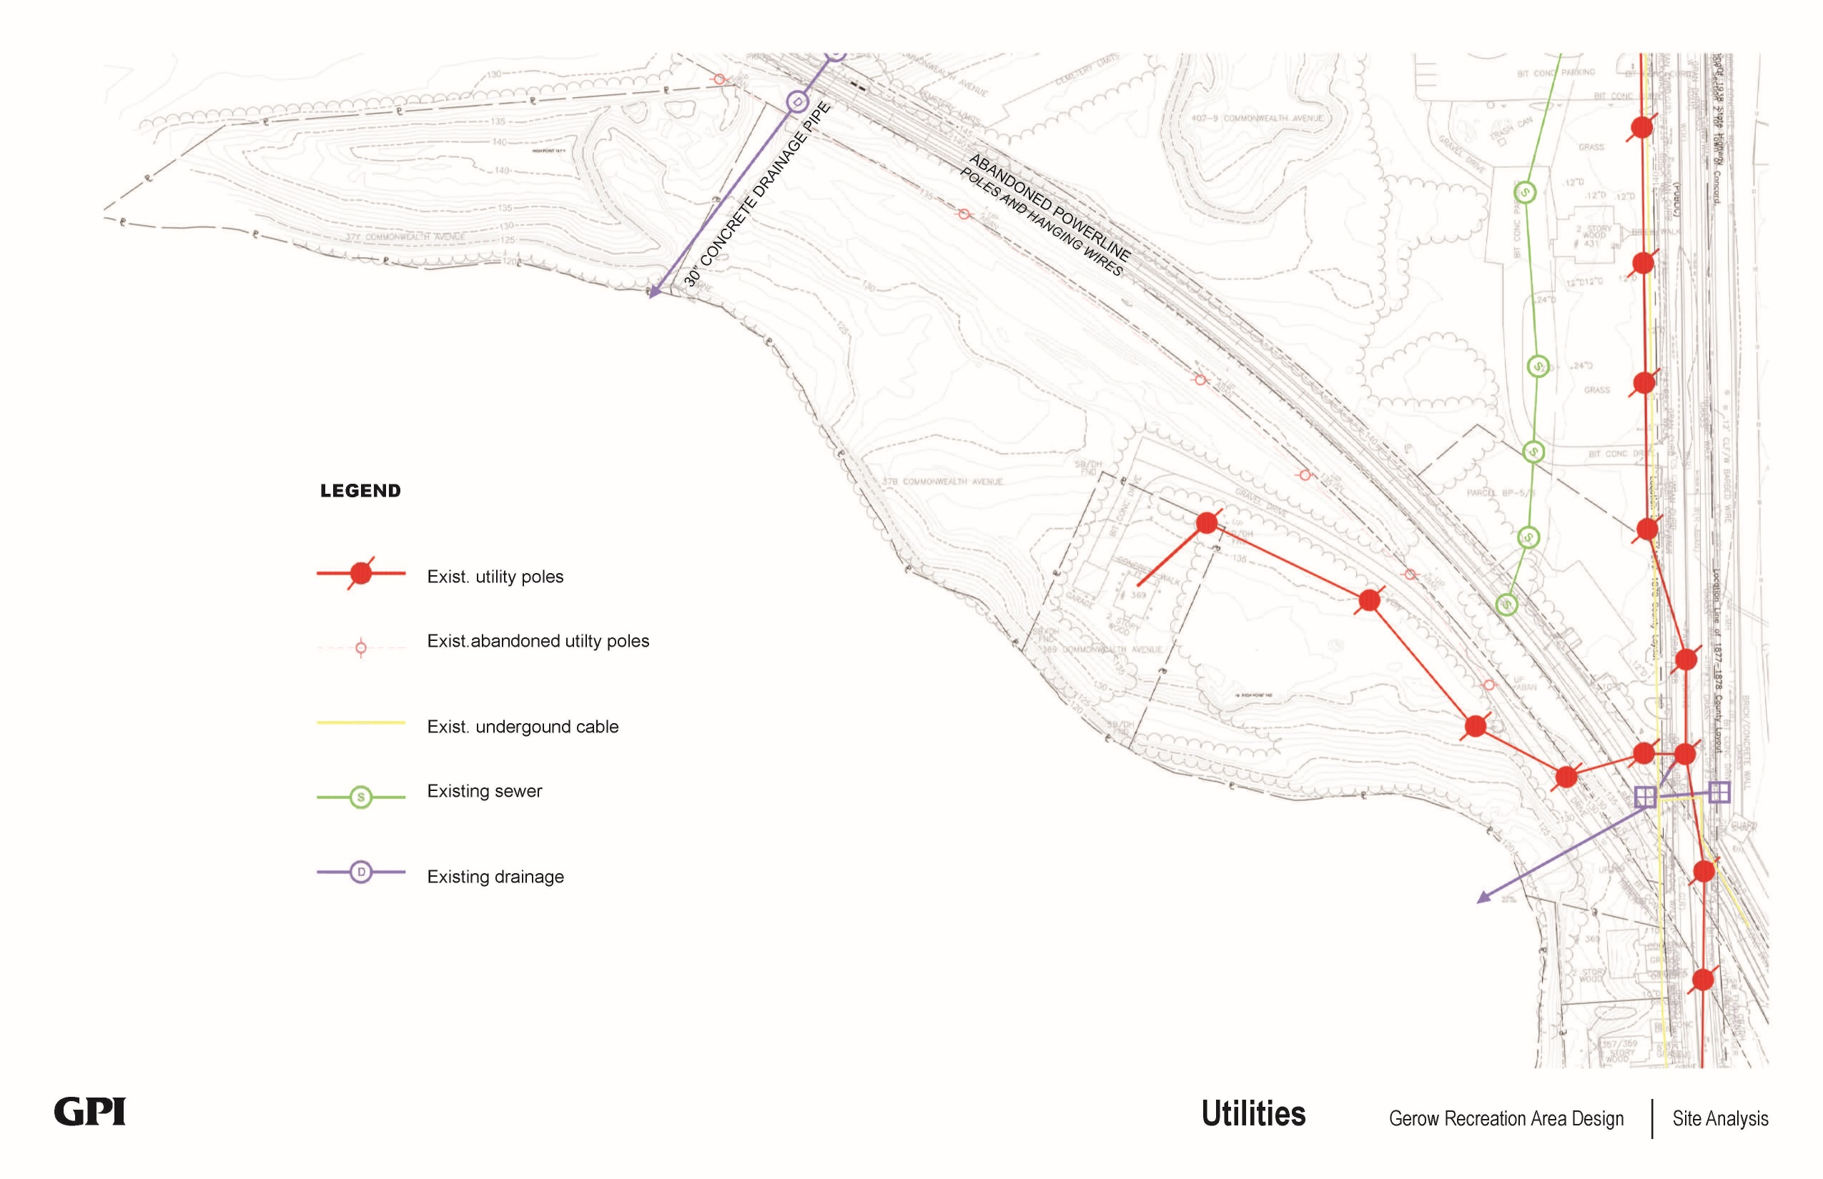
Site Analysis
Notes:
Existing utilities

Slide 14
3 Major Project Components

Slide 15
Environment
Activities
Circulation
Structures
Infrastructure
Gerow
Broad headings or categories that have been identified to encompass a wide variety of assets, conditions, and issues.
Used to consolidate and organize what would otherwise be an unwieldly list of topics.
All items associated with the project should fit under one (or more) of these headings.
Major Project Components
Notes:
Project broken down into 5 broad headings

Slide 16
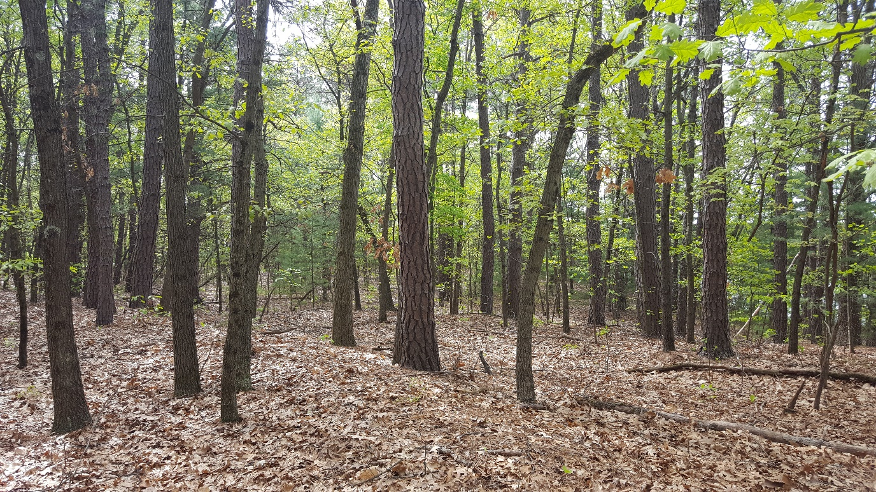
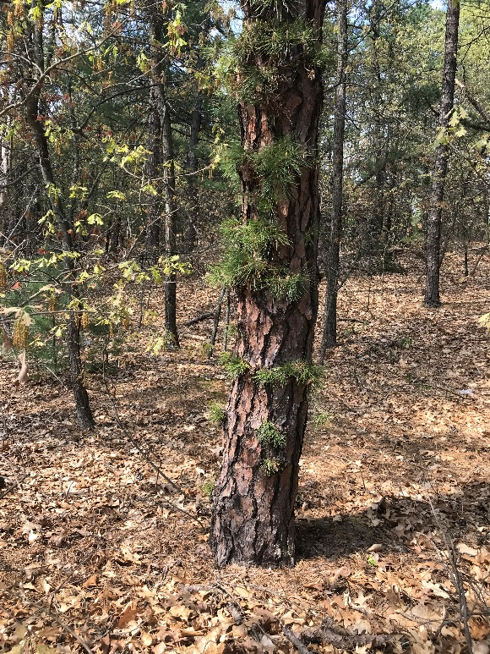
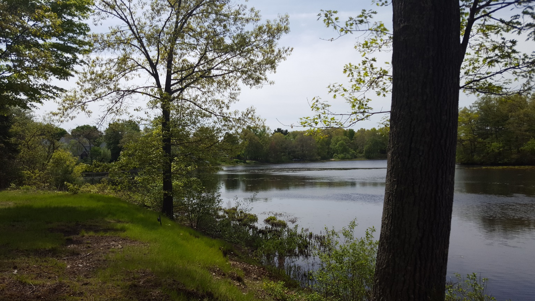
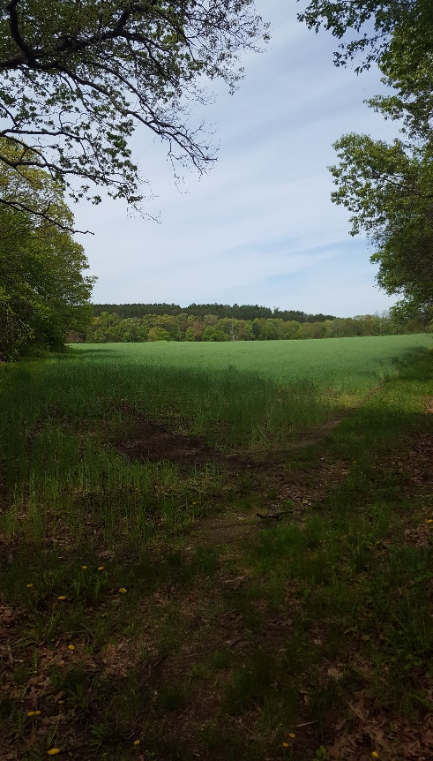
Environment:
Open Space
Reinforce open space
Clear invasive plants
Forested Area
Preserve trees
Raise tree canopy
Shoreline Area
Protect from erosion
Open views to water
Beach Area
Create boat launch

Slide 17
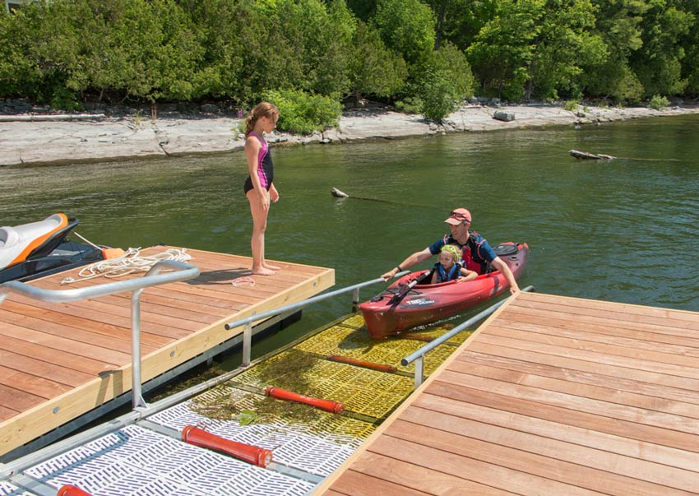
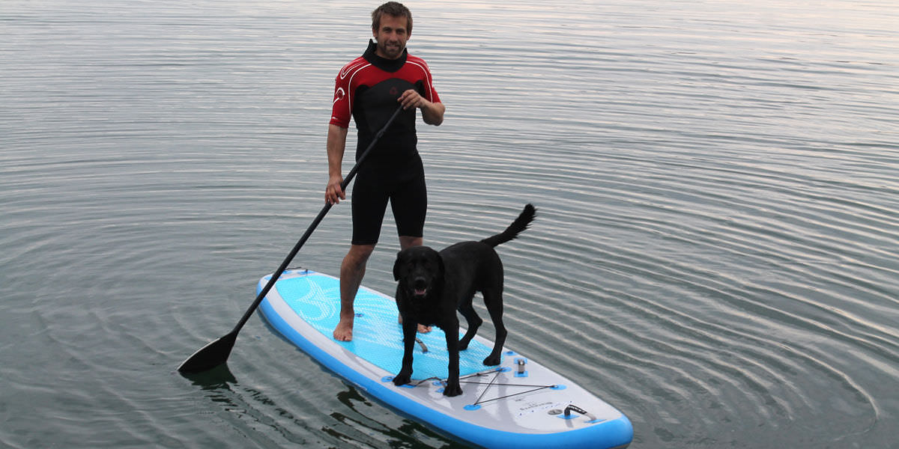
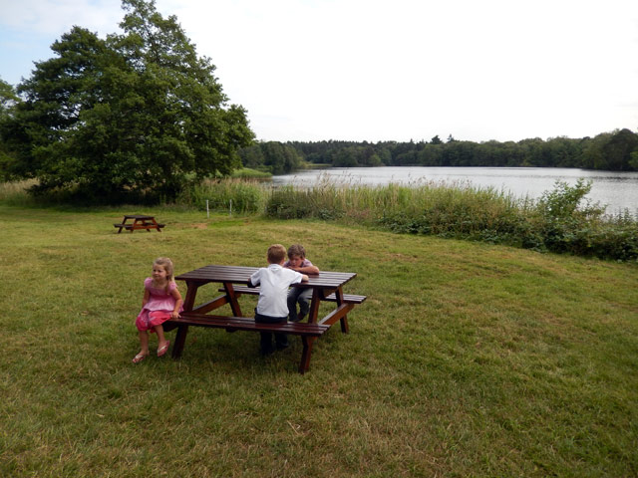
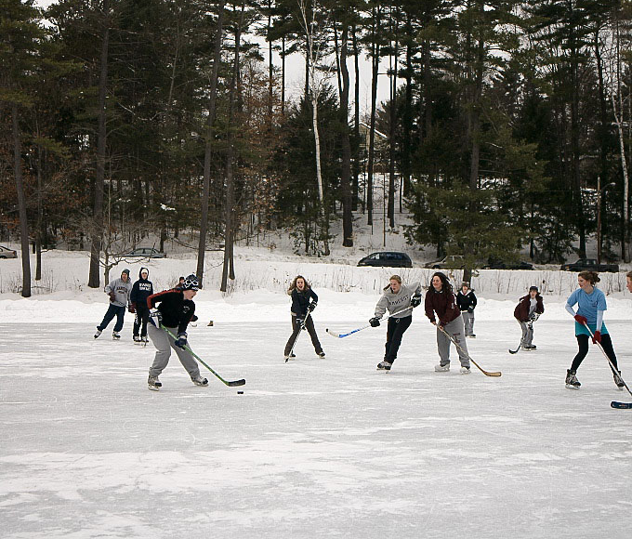
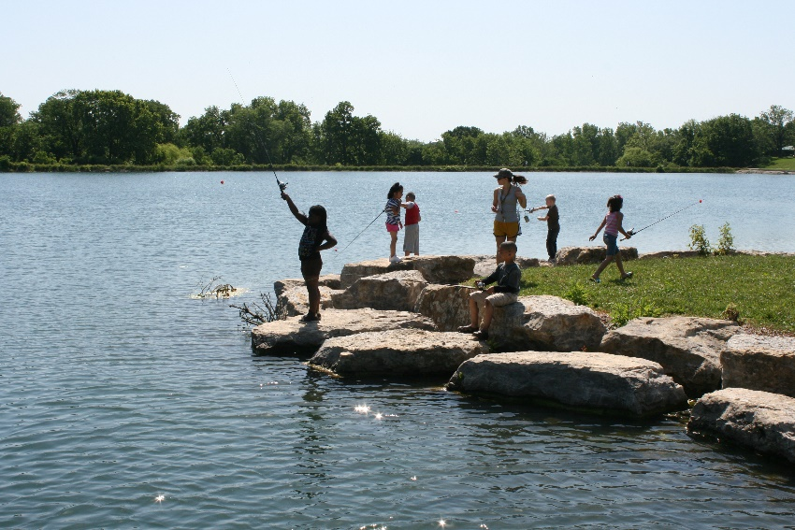
Activities:
Recreation
Active
Boating
Paddle Boarding
Biking
Playground
Ice Skating
Swimming (Future)
Passive
Walking
Fishing
Natural Enjoyment
Gathering
Pavilion(s)
Notes:
Both programmed and informal activities
Recreation and gathering.
Different mix from nearby parks (i.e. Rideout)

Slide 18
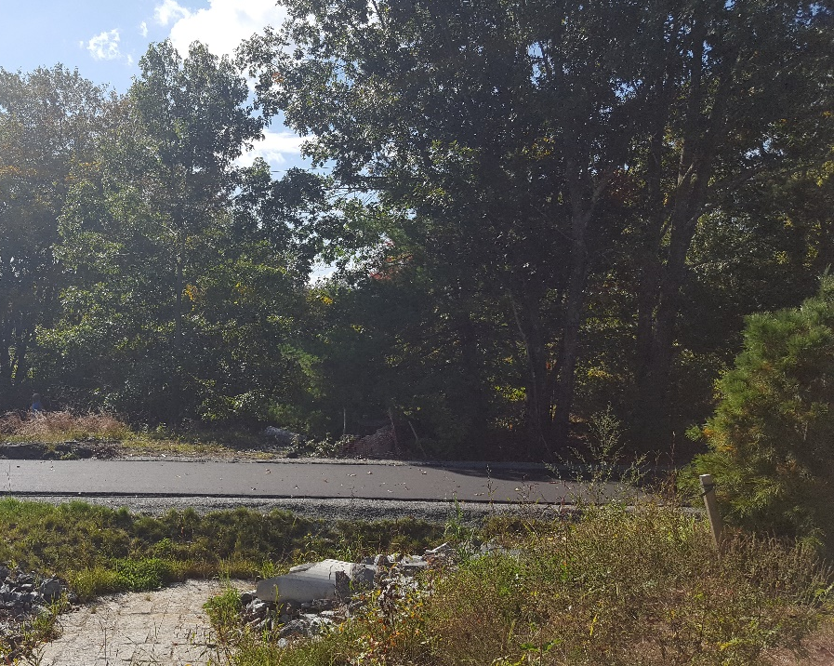
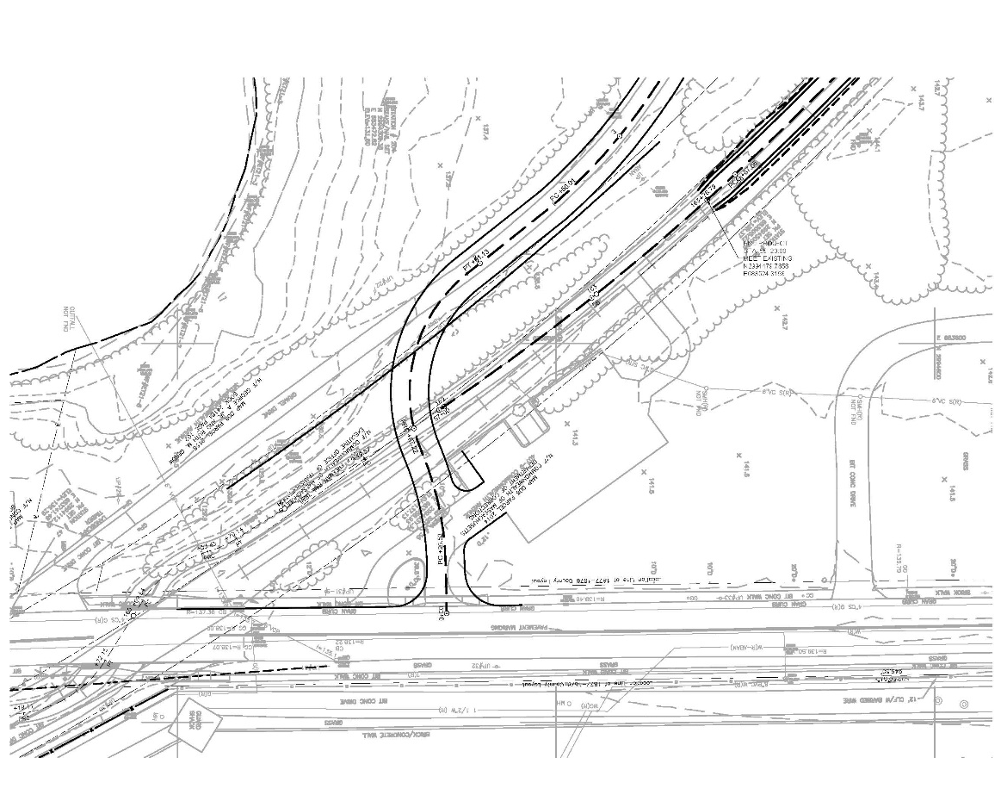
Circulation:
Vehicle Access
Preferred option
Access control
Pedestrian / Bike Access
Accessible paths
Connection to BFRT
Parking
Convenient
Should not dominate
Boat Drop-off
Proximity to launch
Notes:
4 locations reviewed.
Have determined the best location is to tap into parking lot entrance.
Town already owns land.
Easement across BRFT required.

Slide 19
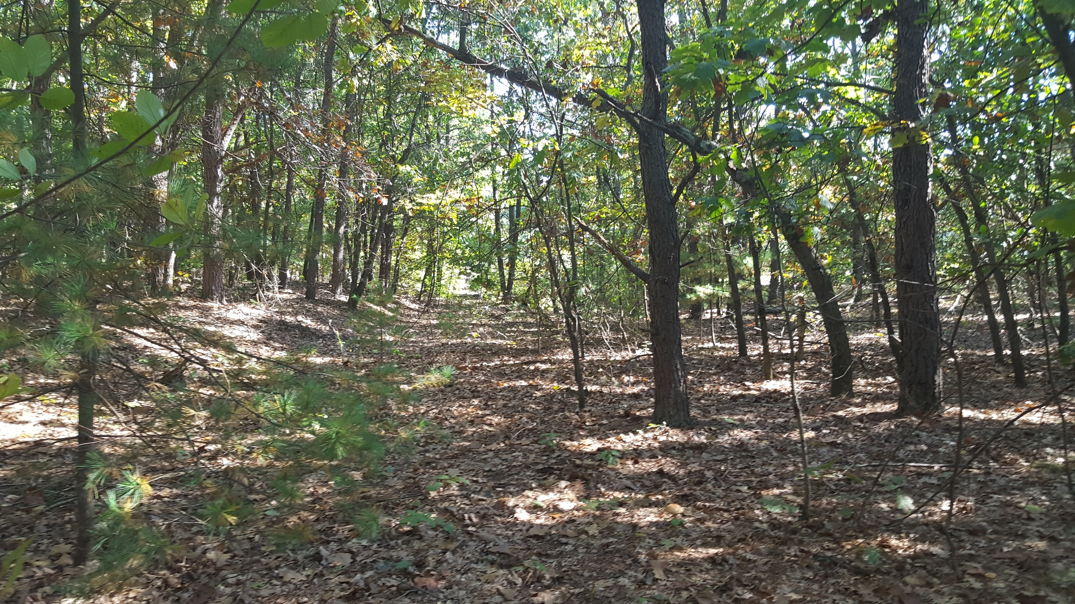
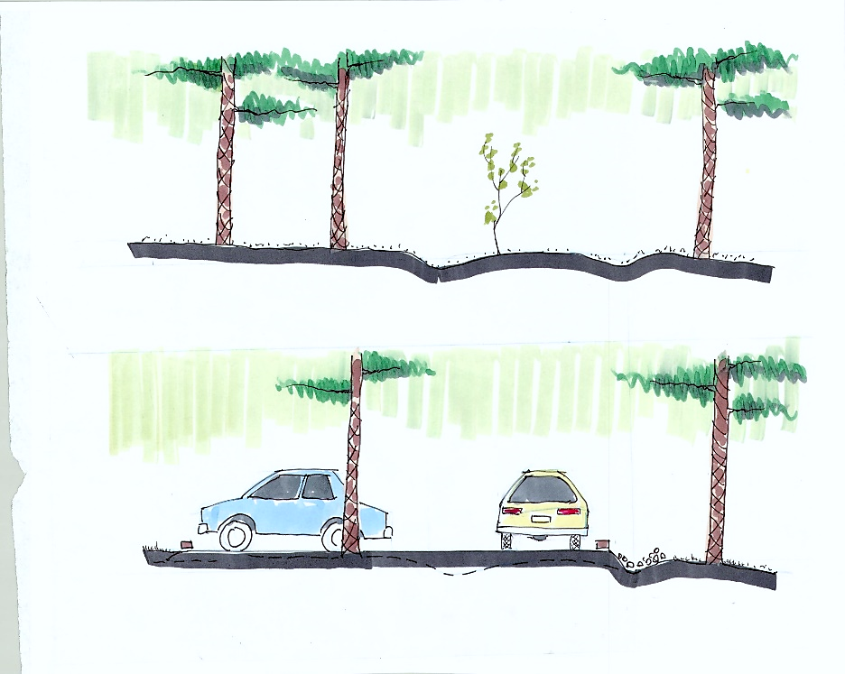
Old Road
Parking
New Road
Swale
Notes:
Reuse of old road bed.
Position new parking to take advantage of down hill swale – pine forest area.

Slide 20
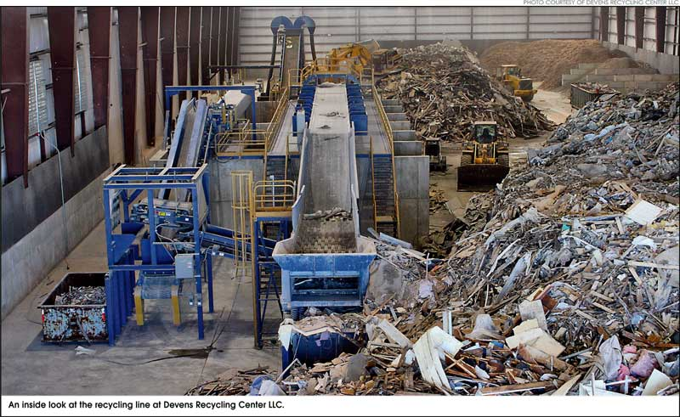
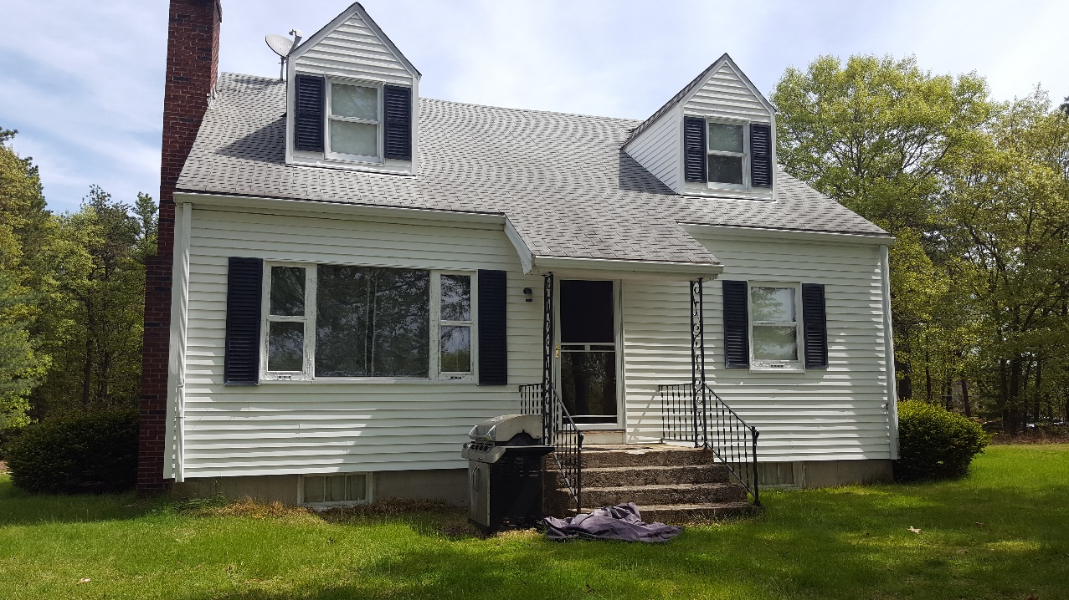

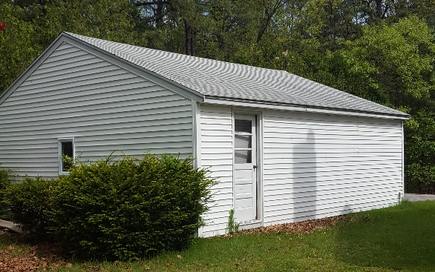
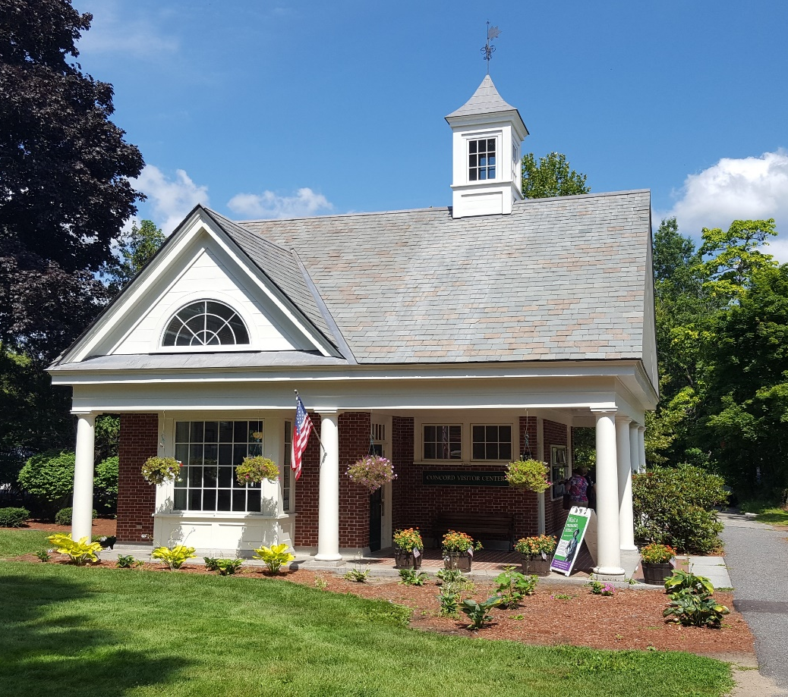
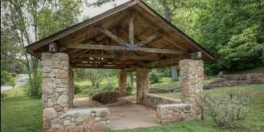
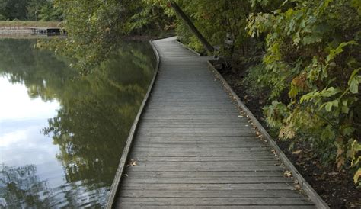
Structures:
Buildings
House Removal
Restroom
Pavilion(s)
Boardwalk/Docks
Notes:
Includes:
House to be removed – green recycling
New restroom, to be similar in footprint to the Visitor’s Center – different styling
1-2 Picnic shelters/pavilions
Shoreline boardwalk and piers

Slide 21
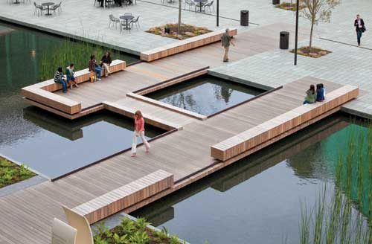
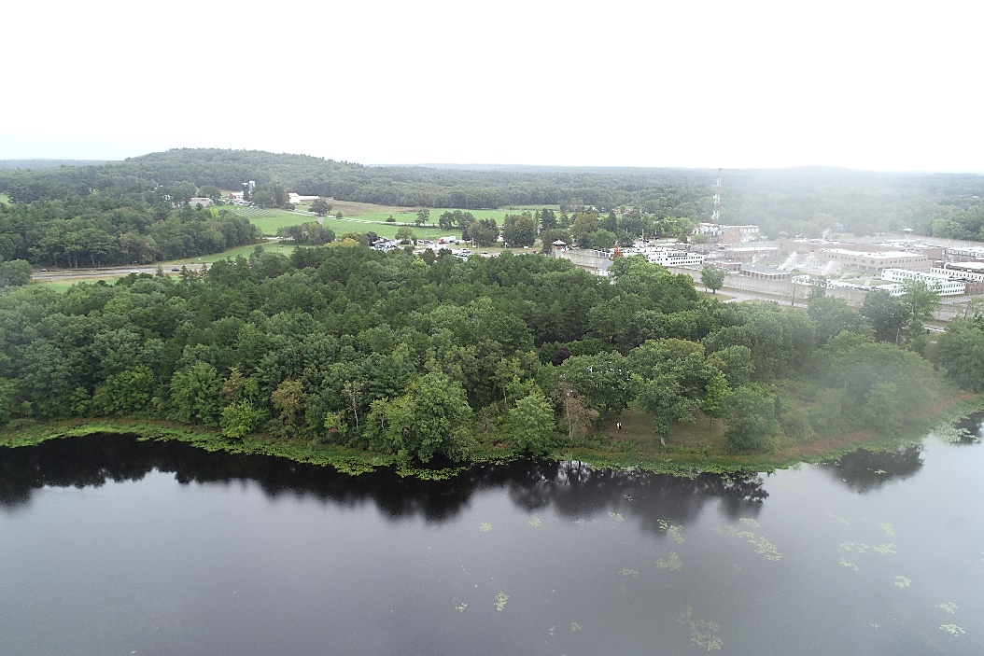
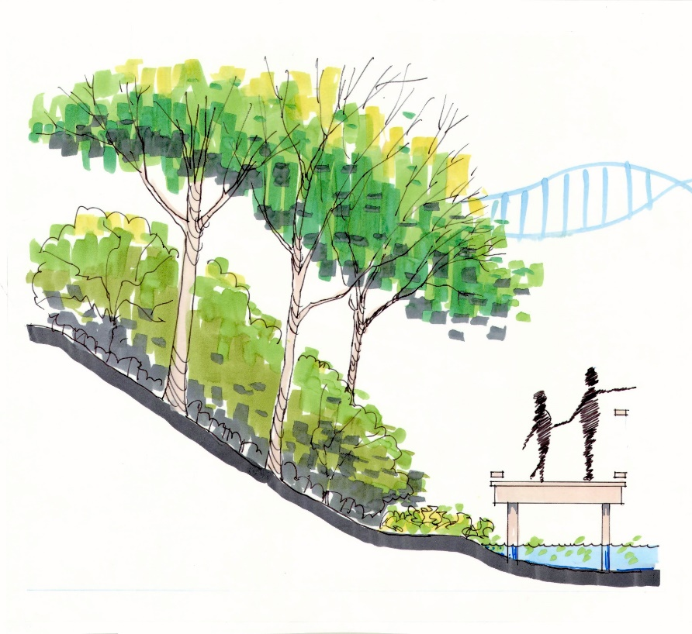
Steep Bank – 25” No disturb
Notes:
Shoreline walk is a central feature of the park
Conceived as a way to protect the steep shore line, yet allow maximum waterfront access.
Minimizes clearing and disturbance
Fixed or floating?
Can be outfitted with benches.
Rail or no rail?

Slide 22
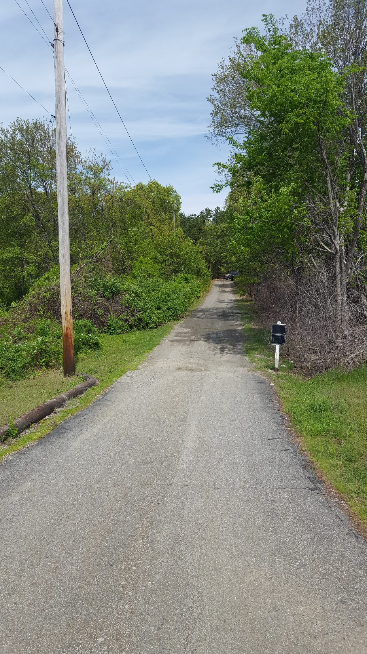
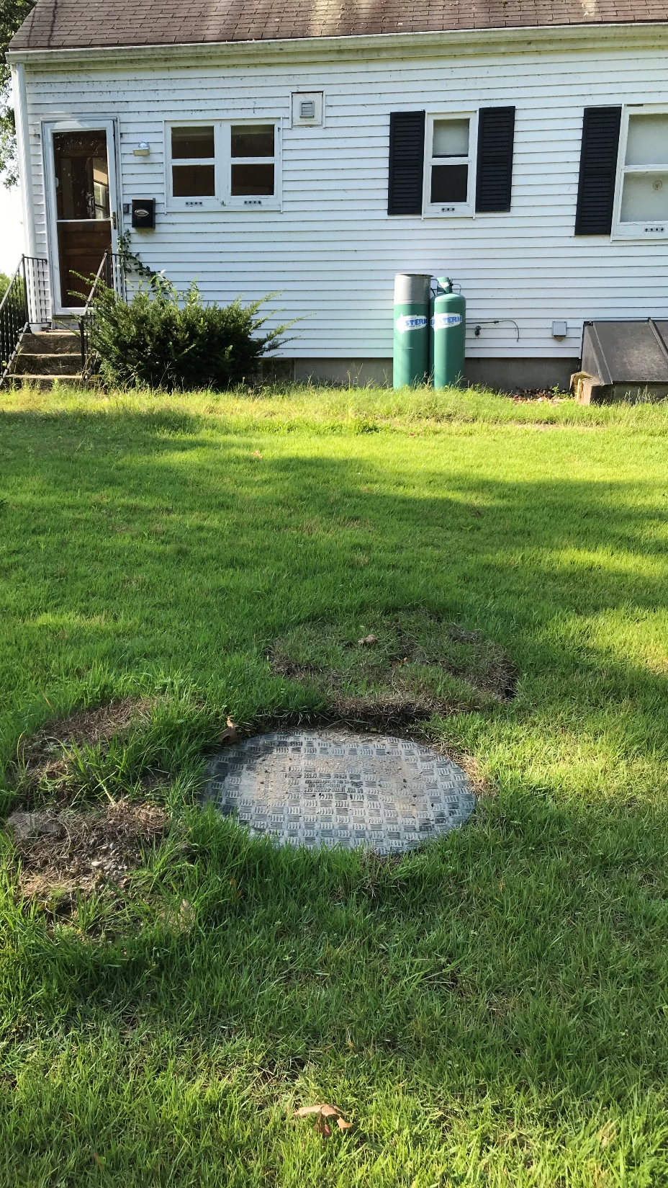
Infrastructure:
Stormwater
Sewer (N/A)
Electric
Water
Lighting
Notes:
Park will require electric, water, and some minimal lighting.
New parking will require stormwater elements to treat runoff.

Slide 23
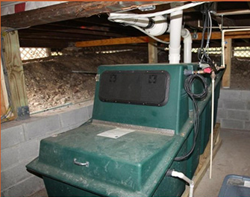
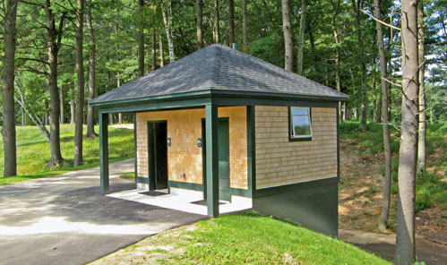
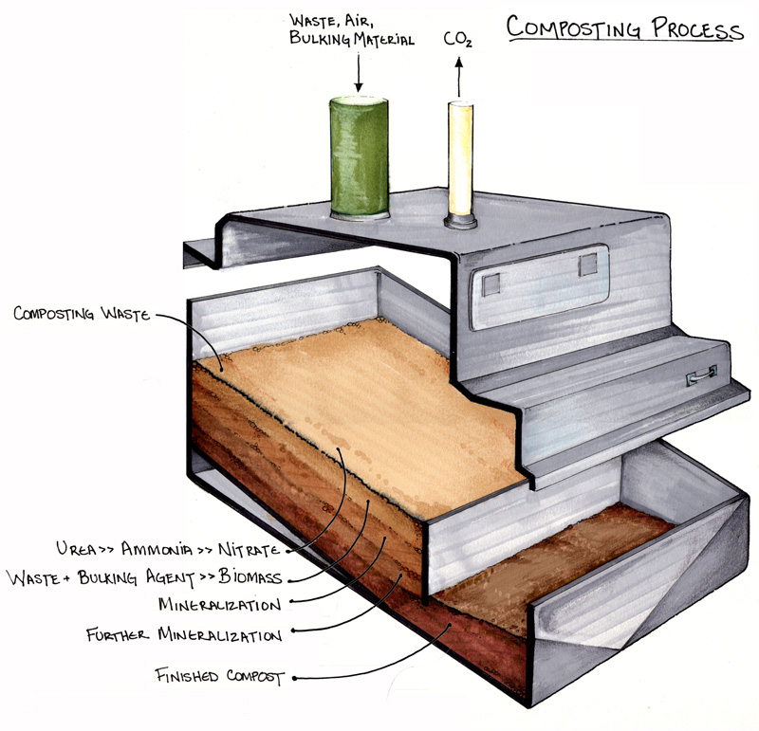
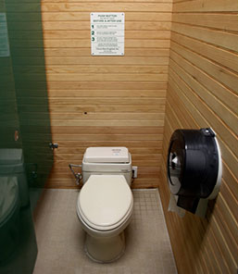
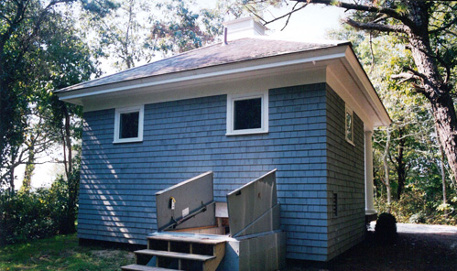
Notes:
Clivus Composting waste treatment system
Examples:
Concord Country Club
New Seabury Country Club

Slide 24
5 Conceptual Options

Slide 25
BFRT
Commonwealth Ave.
Concept
Full Footprint
1
Warner’s
Pond

Slide 26
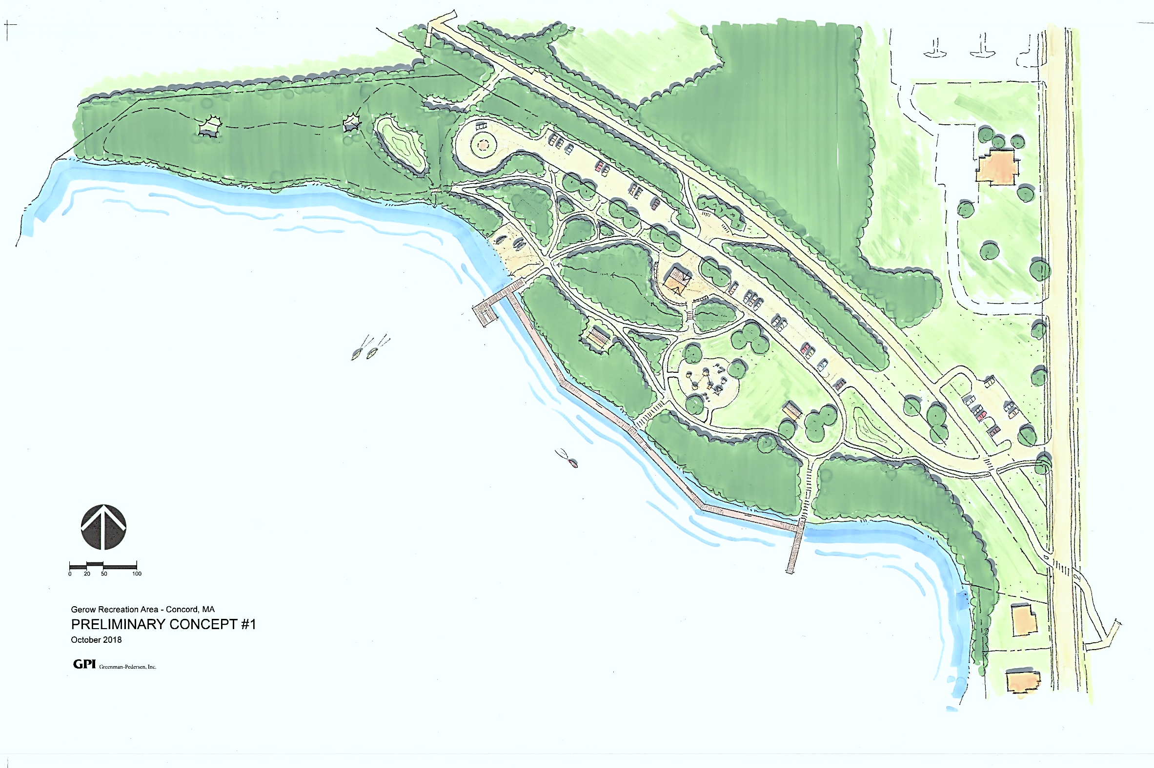
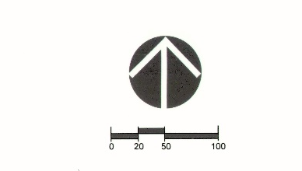
13
11
10
9
12
BFRT
LEGEND
6
8
Open Meadow
Playground
Pavilion
Shoreline Walk
Fishing Pier
Beach / Boat Launch
Accessible Boat Launch
Restrooms
Parking
Fire Ring / Turn Around
Stormwater Basin
Bike Parking
Woodland Trails
Commonwealth Ave.
7
3
2
1
11
4
Concept
1
5
Warner’s
Pond
Notes:
50 total spaces
Handicap = 2 (25-50)
580 + 90 + 90 = 760 LF

Slide 27
BFRT
Commonwealth Ave.
Reduced Footprint
Concept
2
Warner’s
Pond

Slide 28
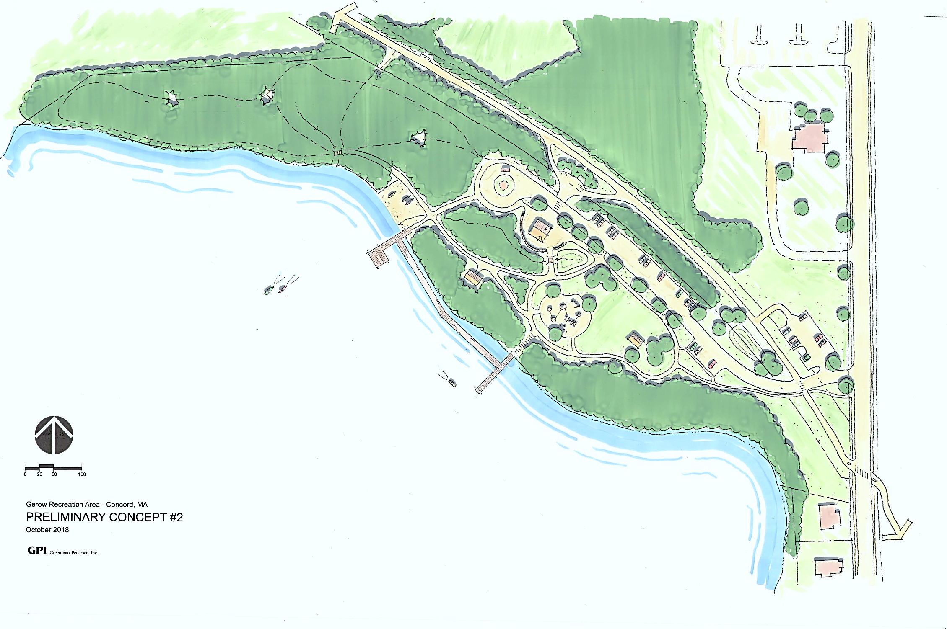
13
10
BFRT
12
LEGEND
6
Open Meadow
Playground
Pavilion
Shoreline Walk
Fishing Pier
Beach / Boat Launch
Accessible Boat Launch
Restrooms
Parking
Fire Ring / Turn Around
Stormwater Basin
Bike Parking
Woodland Trails
8
Commonwealth Ave.
11
9
7
3
2
4
1
11
5
Concept
2
Warner’s
Pond
Notes:
33 spaces
Handicap = 1 space (15-25)
290 + 90 + 90 = 470 LF

